Slide 1
BRANDING
Ver1.0

Slide 2
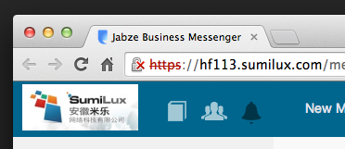
Company Logo-webclient
Fav icon
Org logo

Slide 3
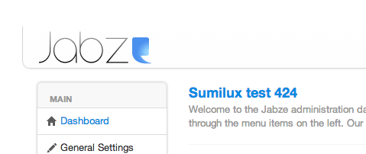
Company Logo-admin
Org logo
Org name

Slide 4


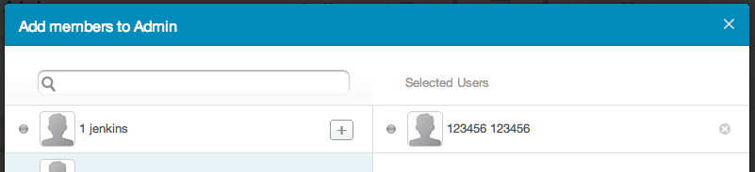
Company color
顶部导航
Send按钮
setting/Chat图标
Add member对话框 顶部颜色

Slide 5
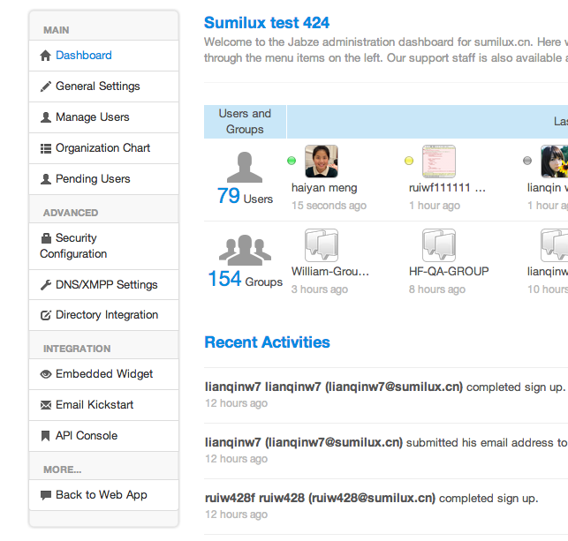
Admin color

Slide 6
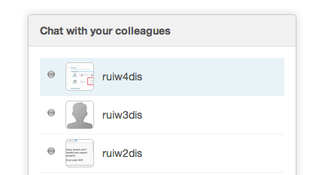
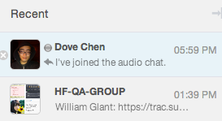
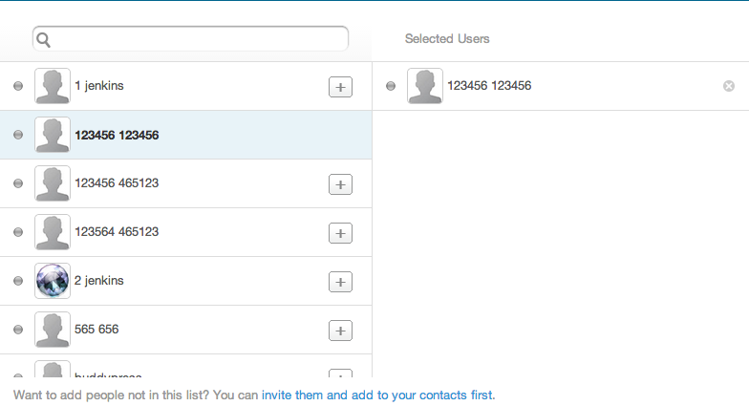
Mouse hoover color

Slide 7
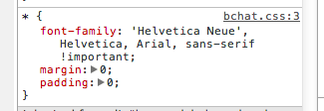
Company website font

Slide 8
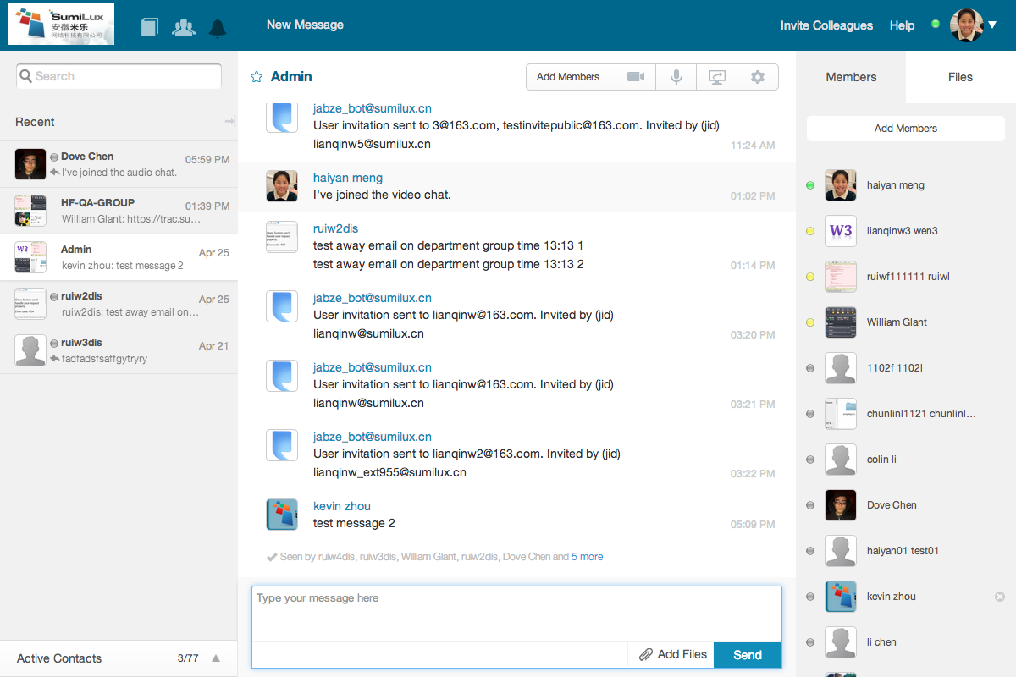
Webclient font
导航
对话标题Group/user name
消息username
标题
Send按钮

Slide 9
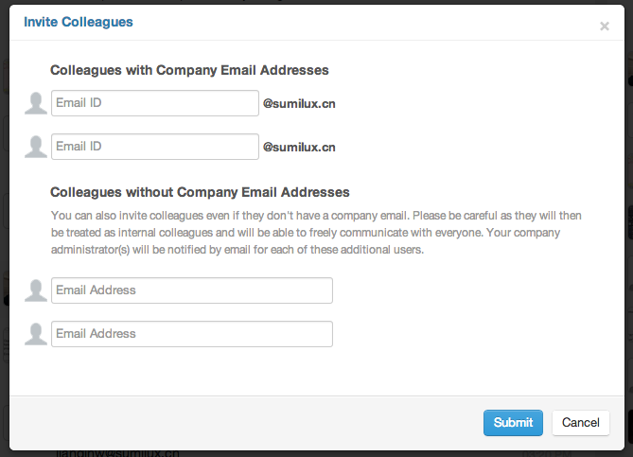
Company font

Slide 10
Admin font

Slide 11
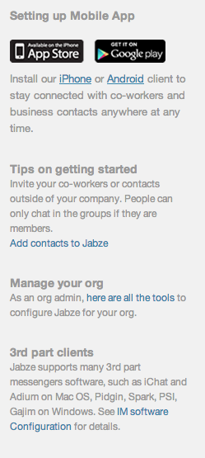
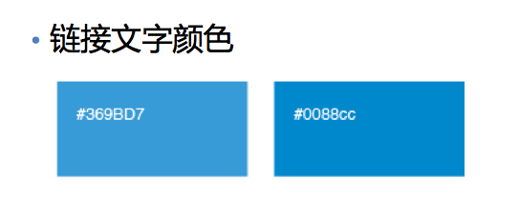
Superlink color
Normal Hover

